Slide 1


SIVARAMAN VISHAL RAMANATHAN
19 DECEMBER 2023

Slide 2

Outline
Executive Summary.
Introduction.
Methodology.
Results.
Conclusion.
Appendix.

Slide 3
Executive Summary
Summary of methodologies :
Data Collection through API.
Data Collection with Web Scraping.
Data Wrangling.
Exploratory Data Analysis with SQL.
Exploratory Data Analysis with Data Visualization.
Interactive Visual Analytics with Folium.
Machine Learning Prediction.
Summary of all results :
Exploratory Data Analysis result.
Interactive analytics screenshots.
Predictive Analytics result.

Slide 4
Introduction
Project background and context :
SpaceX spent around 62 million on Falcon 9 rocket launches.
The fact that SpaceX can land and reuse the rocket's first stage accounts for a considerable amount of the savings as compared to other providers, which normally charge more than 165 million.
If we are able to predict whether the first stage will land, we can use this information to estimate the cost of a launch and determine whether another company should compete with SpaceX for a rocket launch.
Ultimately, this research will be able to predict whether or not the Space X Falcon 9 first stage will land successfully.
Problems you want to find answers :
What elements affect the rocket's likelihood of a successful landing
The way in which different elements interact to determine the likelihood of a successful landing
What operational conditions must be met in order to guarantee the success of the landing programme

Slide 5

Section 1

Slide 6
Methodology
Executive Summary
Data collection methodology:
Utilising the spaceX API and web scraping from Wikipedia, data was gathered.
Perform data wrangling
We used one-hot encoding on the categorical features.
Perform exploratory data analysis (EDA) using visualization and SQL
Perform interactive visual analytics using Folium and Plotly Dash
Perform predictive analysis using classification models
Building the optimal model for Machine Learning.

Slide 7
Data Collection
Describe how data sets were collected :
Utilising a receive call to the SpaceX API, data was gathered.
Next, we used the.json() function call to decode the response content as JSON and the.json_normalize() method to convert it into a pandas dataframe.
After that, we cleaned the data, looked for any missing values, and, if needed, filled them in.
Additionally, we used BeautifulSoup to perform web scraping of Wikipedia to find launch records for the Falcon 9.
The aim was to retrieve the launch records in the form of an HTML table, parse the information, and then transform it into a pandas dataframe for upcoming examination.

Slide 8

Data Collection – SpaceX API
The SpaceX API's get request was utilised to gather data, clean the requested data, and do some simple data wrangling and formatting.
GitHub URL : https://github.com/Sivaraman-VishalRamanathan/FINAL_CAPSTON_PROJECT_IBM_DATA_SCIENCE/blob/main/Vishal_Ramanathan_20231218_jupyter-labs-spacex-data-collection-api.ipynb

Slide 9

Data Collection - Scraping
Using BeautifulSoup, we used web scraping to gather Falcon 9 launch records. The table was parsed, and a pandas dataframe was created.
GitHub URL : https://github.com/Sivaraman-VishalRamanathan/FINAL_CAPSTON_PROJECT_IBM_DATA_SCIENCE/blob/main/Vishal_Ramanathan_20231218_jupyter-labs-webscraping.ipynb

Slide 10

Data Wrangling
We identified the training labels by doing an exploratory data analysis.
We determined the quantity of launches at every location as well as the quantity and frequency of each orbit.
From the outcome column, we generated the landing outcome label and exported the data to CSV.
GitHub URL : https://github.com/Sivaraman-VishalRamanathan/FINAL_CAPSTON_PROJECT_IBM_DATA_SCIENCE/blob/main/Vishal_Ramanathan_20231218_labs-jupyter-spacex-Data%20wrangling.ipynb

Slide 11
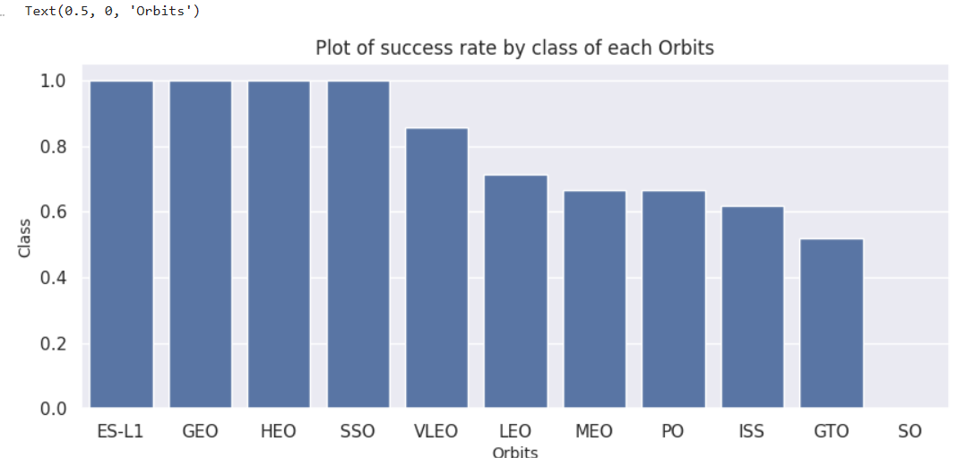
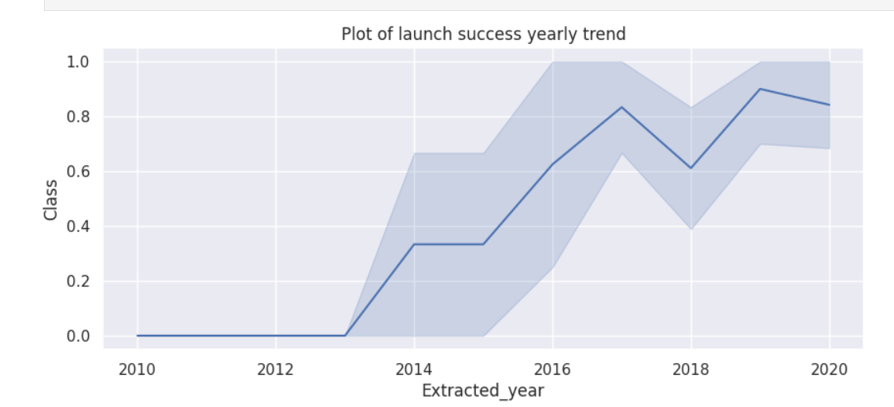
EDA with Data Visualization
In order to better understand the data, we plotted the relationships between the flight number vs the launch site, the payload vs the launch site, the success rate of each orbit type, the flight number vs the orbit type, and the annual trend of launch success.
GitHub URL : https://github.com/Sivaraman-VishalRamanathan/FINAL_CAPSTON_PROJECT_IBM_DATA_SCIENCE/blob/main/Vishal_Ramanathan_20231219jupyter-labs-eda-dataviz.ipynb.jupyterlite.ipynb

Slide 12
EDA with SQL
The SpaceX dataset was loaded into a PostgreSQL database without requiring us to exit the Jupyter notebook.
To extract meaning from the data, we used SQL and EDA. We created queries to, for example, find out :
The space mission's distinct launch sites' names.
The total mass of payload that NASA's CRS boosters have carried.
The rocket version F9 v1.1's average payload mass.
The total number of outcomes from missions that were successful or unsuccessful.
Drone ship's unsuccessful landing results, along with the names of the launch sites and booster versions.
GitHub URL : https://github.com/Sivaraman-VishalRamanathan/FINAL_CAPSTON_PROJECT_IBM_DATA_SCIENCE/blob/main/Vishal_Ramanathan_20231219_jupyter-labs-eda-sql-coursera_sqllite.ipynb

Slide 13
Build an Interactive Map with Folium
After initialising the map and adding a folium circle and marker for each launch site that has been provided, mark all of the launch sites on it using the NASA coordinates.
Determine and label triumphs and setbacks, create clusters, create an icon as a text title, give an icon colour, and launch sites by providing dummy variables, such as 1 for success and 0 for failure.
The process of measuring the distance between a launch site and its surroundings involves locating launch sites, figuring out the distance between latitude and longitude, making a folium marker to indicate the distance, and adding these characteristics to the map.
The Space X launch sites were marked with folium markers, along with the locations of nearby significant landmarks such as cities, highways, trains, and beaches.
The launch sites were connected to the closest land points using polylines.
Failures to launch rockets are shown by red.
Green stands for success.
GitHub URL : https://github.com/Sivaraman-VishalRamanathan/FINAL_CAPSTON_PROJECT_IBM_DATA_SCIENCE/blob/main/Vishal_Ramanathan_20231220_lab_jupyter_launch_site_location.jupyterlite.ipynb

Slide 14
Build a Dashboard with Plotly Dash
A Plotly Dash dashboard was enhanced with the following plots to provide an interactive data visualisation.
Pie chart (px.pie()) displaying each site's total number of successful launches.
This makes it easy to identify the most successful websites.
A dcc.Dropdown() object might be used to filter the chart and view the success/failure ratio for a certain site.
The scatter graph (px.scatter()) illustrates the relationship between the payload mass (kg) and the outcome (success or failure).
This could have ranges of payload masses blocked off (using a RangeSlider() object).
Moreover, booster version could be used to filter it.
GitHub URL : https://github.com/Sivaraman-VishalRamanathan/FINAL_CAPSTON_PROJECT_IBM_DATA_SCIENCE/blob/main/Vishal_Ramanathan_Dash_app.py

Slide 15
Predictive Analysis (Classification)
To create, assess, and determine which categorization model performed the best, the following procedures were followed:
Model Creation :
Download the dataset.
Carry out the appropriate preprocessing and standardisation of data.
Use train_test_split to divide data into training and test data sets.
Choose the most suitable kind of machine learning algorithms.
Generate a dictionary of parameters and a GridSearchCV object.
Align the item with the specifications.
Train the model using the training data set.

Slide 16
Predictive Analysis (Classification) contd.
Assessment of the Model :
Verify the adjusted hyperparameters (best_params_) and accuracy (score and best_score_) using the GridSearchCV object that is produced.
Create a plot and study the confusion matrix.
Choosing the optimal model for FIT classification :
Examine the accuracy ratings of each selected algorithm.
The model that performs the best is the one with the highest accuracy score.
GitHub URL : https://github.com/Sivaraman-VishalRamanathan/FINAL_CAPSTON_PROJECT_IBM_DATA_SCIENCE/blob/main/Vishal_Ramanathan_20231220_SpaceX_Machine_Learning_Prediction_Part_5.jupyterlite.ipynb

Slide 17
Results
Exploratory data analysis results
Interactive analytics demo in screenshots
Predictive analysis results

Slide 18

Section 2

Slide 19
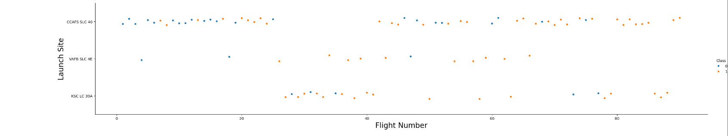
Flight Number vs. Launch Site
The number of flights is rising, and launch sites are seeing an increase in success rates as well.
As the number of flights rose, it seems that more landings were successful.
The most landings were at launch location CCAFS SLC 40.

Slide 20
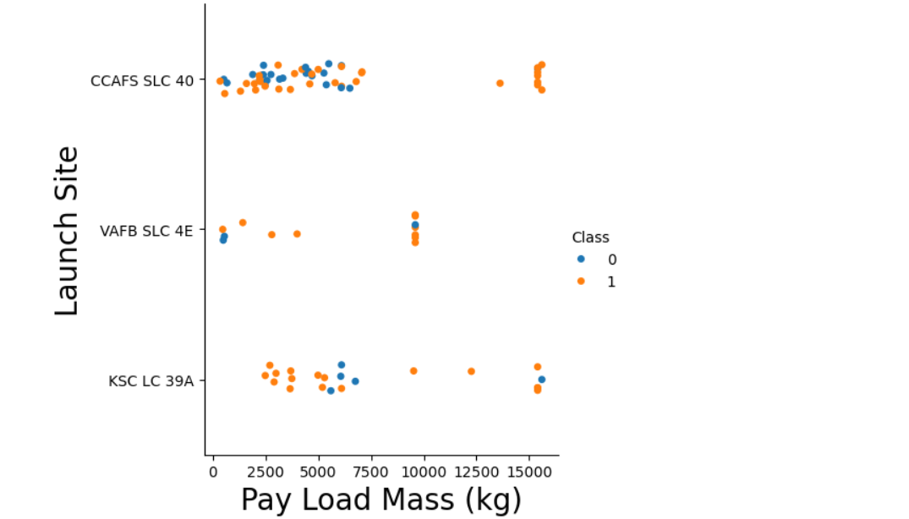
Payload vs. Launch Site
As the payload mass increases, launch sites are seeing a rise in success rates as well.
As you can see from the scatter point chart, no rockets with a significant payload mass (more than 10,000) have been launched from the VAFB-SLC launch site.

Slide 21
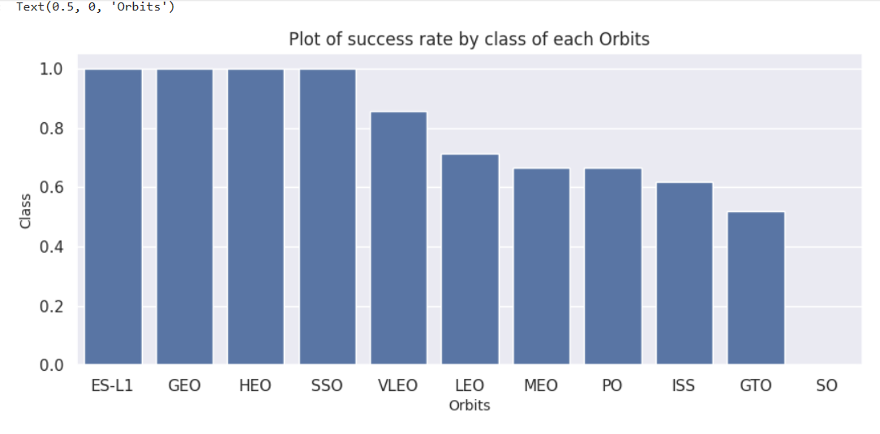
Success Rate vs. Orbit Type
The plot indicates that the highest success rates were attained by ES-L1, GEO, HEO, SSO, and VLEO.
SO has a success rate of 0.

Slide 22
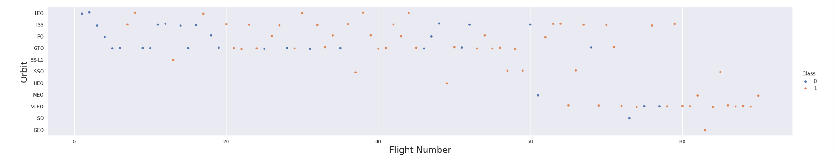
Flight Number vs. Orbit Type
We see that while there is no correlation between flight number and orbit in the GTO orbit, success in the LEO orbit is correlated with the number of flights.

Slide 23
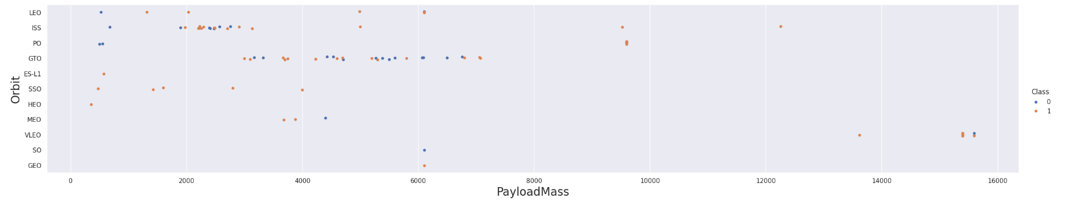
Payload vs. Orbit Type
We can see that more successful landings for PO, LEO, and ISS orbits occur when heavy payloads are carried.
The first thing to observe is the impact on ISS of the Pay load Mass between 2000 and 3000.
For GTO, on the other hand, it is difficult to discern between positive landing rate and negative landing rate (unsuccessful mission).
GTO is also impacted by pay load mass between 3000 and 7000.

Slide 24
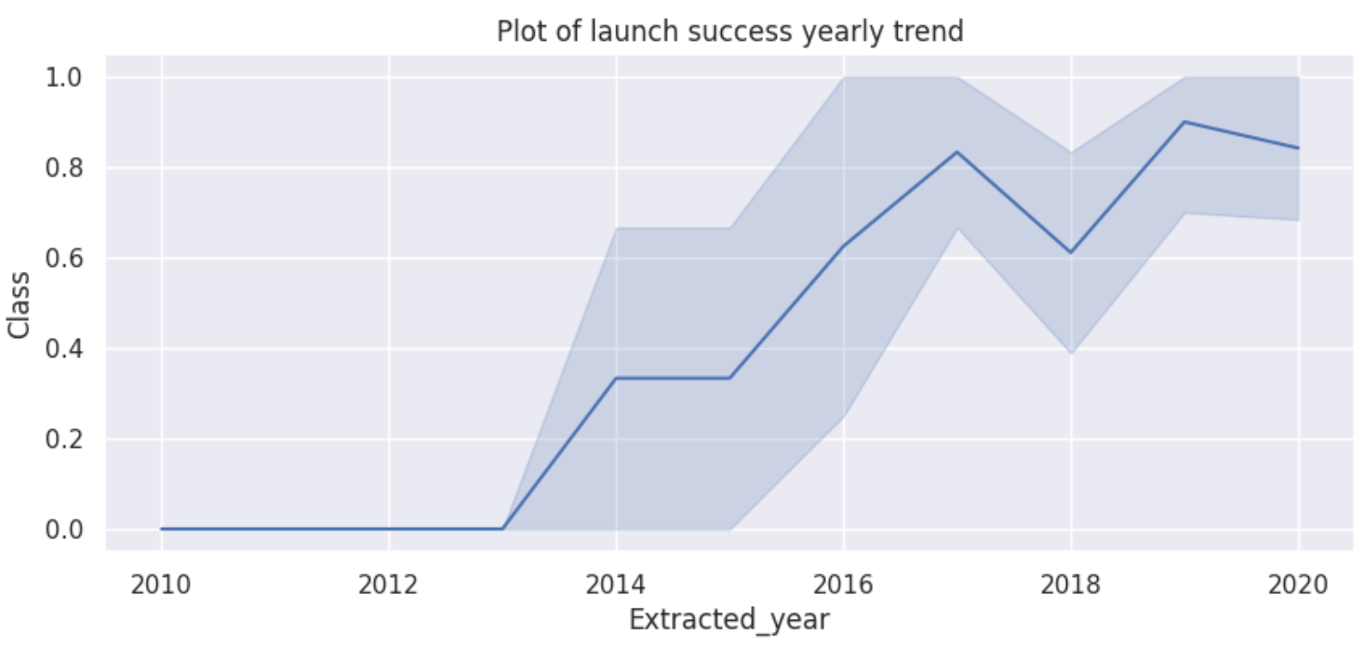
Launch Success Yearly Trend
It is evident that between 2013 and 2020, the success rate grew dramatically.
The success rate has significantly increased since 2013. It did, however, somewhat decline in 2018 before gaining strength again.

Slide 25
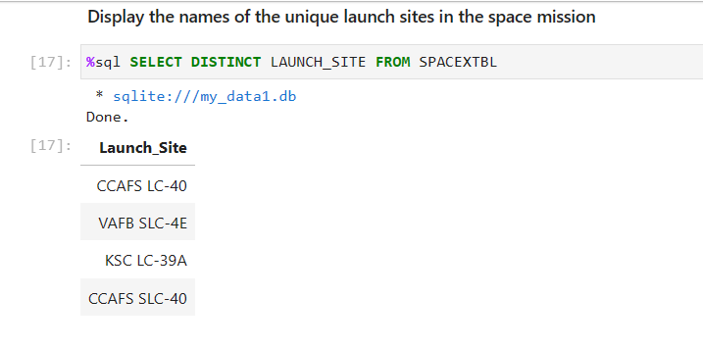
All Launch Site Names
"DISTINCT" key word allows us to obtain the unique values.

Slide 26
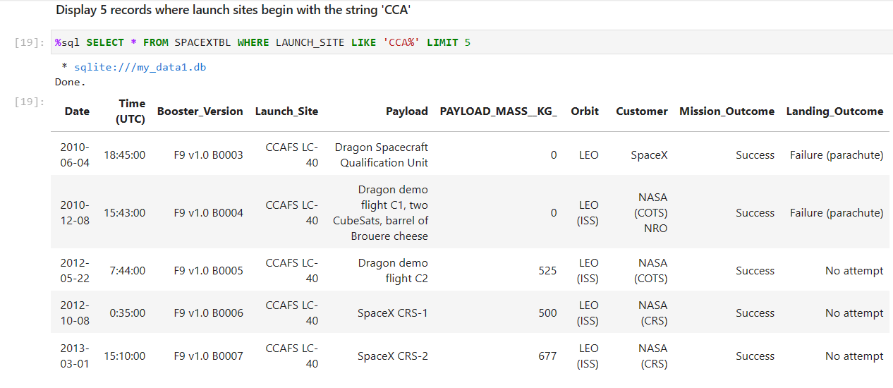
Launch Site Names Begin with ‘CCA’
Using "LIMIT," we are only able to obtain 5 rows.

Slide 27
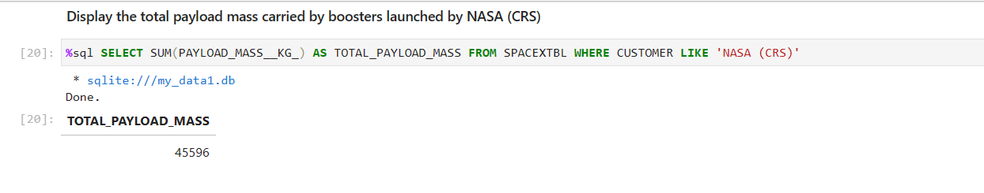
Total Payload Mass
Using "SUM," we can obtain the total of all values.

Slide 28
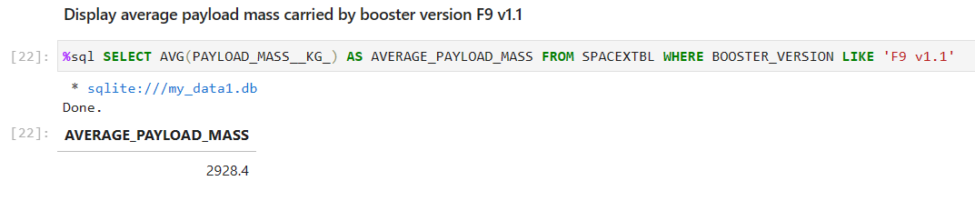
Average Payload Mass by F9 v1.1
The "AVG" function allows us to obtain the average of all values.

Slide 29
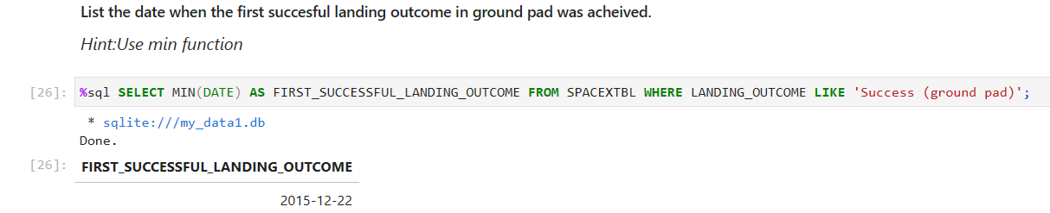
First Successful Ground Landing Date
As we can see, on December 22, 2015, the first ground pad was successfully launched.

Slide 30
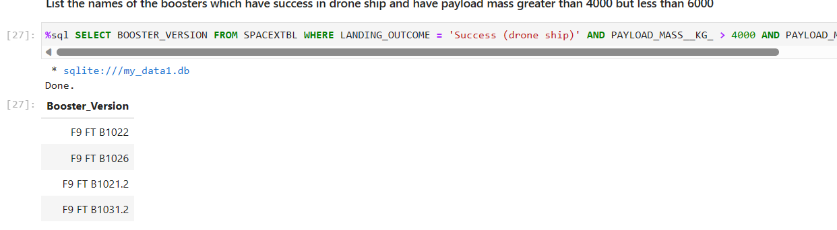
Successful Drone Ship Landing with Payload between 4000 and 6000
The landing result was identified as a "success drone" after the payload mass data was only collected between 4000 and 6000.

Slide 31
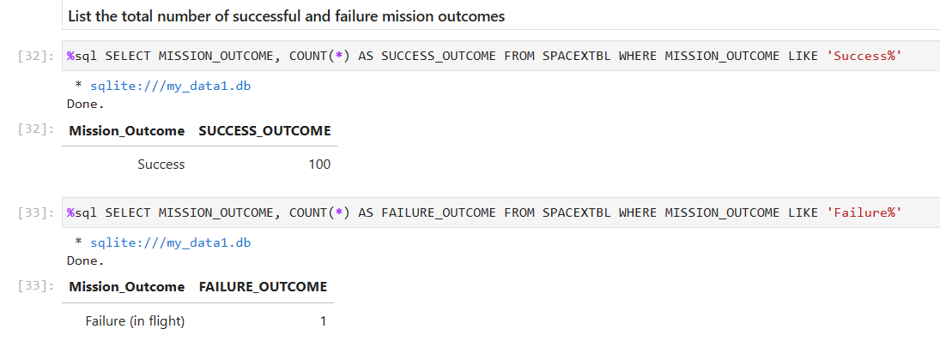
Total Number of Successful and Failure Mission Outcomes
We may use "COUNT" and LIKE "Success%" and "Failure%" to obtain the total number of successful and Failure missions.

Slide 32
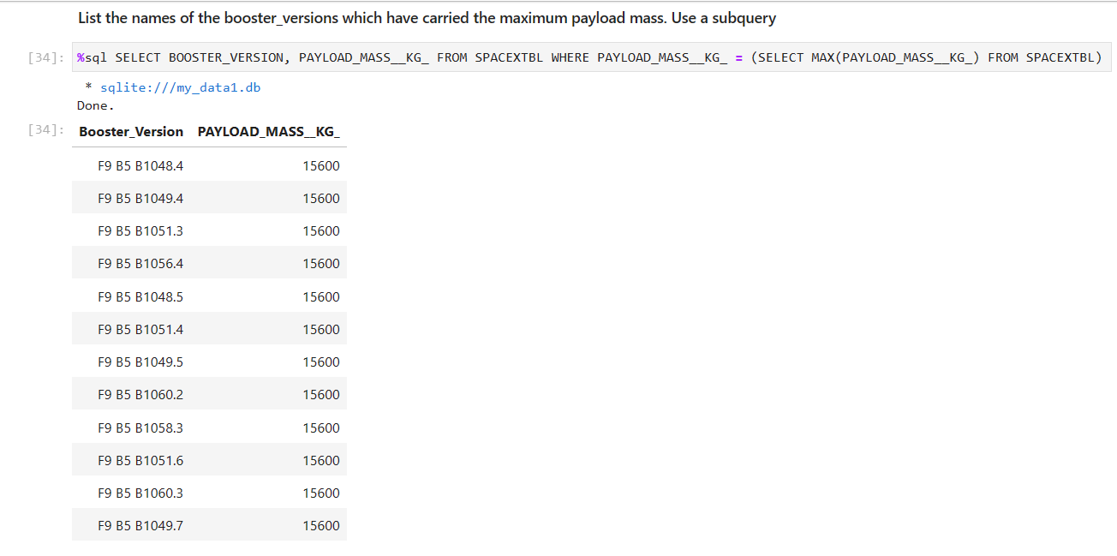
Boosters Carried Maximum Payload
We can get the maximum payload masses by using “MAX” function.

Slide 33
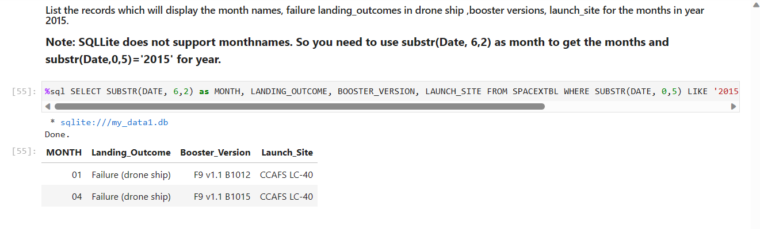
2015 Launch Records
Month(DATE) can be used to obtain the months, and "2015" is the year value that we supplied to the WHERE function.

Slide 34
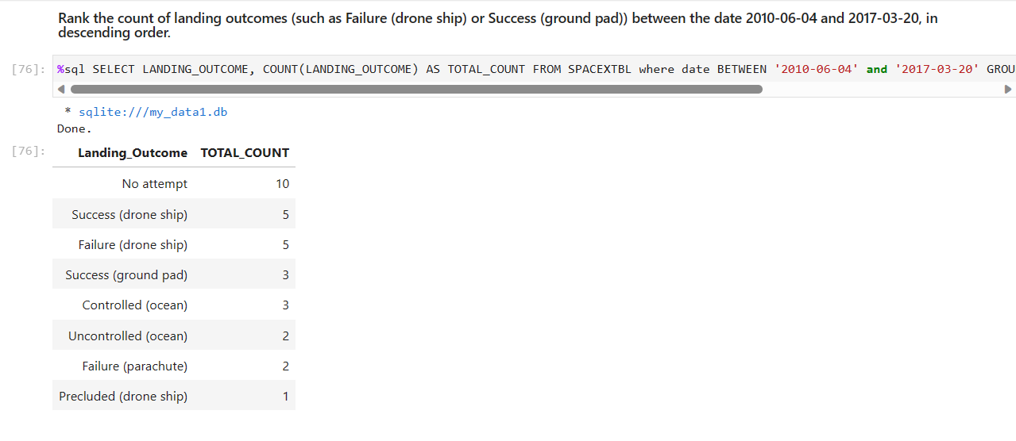
Rank Landing Outcomes Between 2010-06-04 and 2017-03-20
We may arrange the values in decreasing order by using "ORDER," and we can count all of the numbers as we did before by using "COUNT."

Slide 35

Section 3

Slide 36
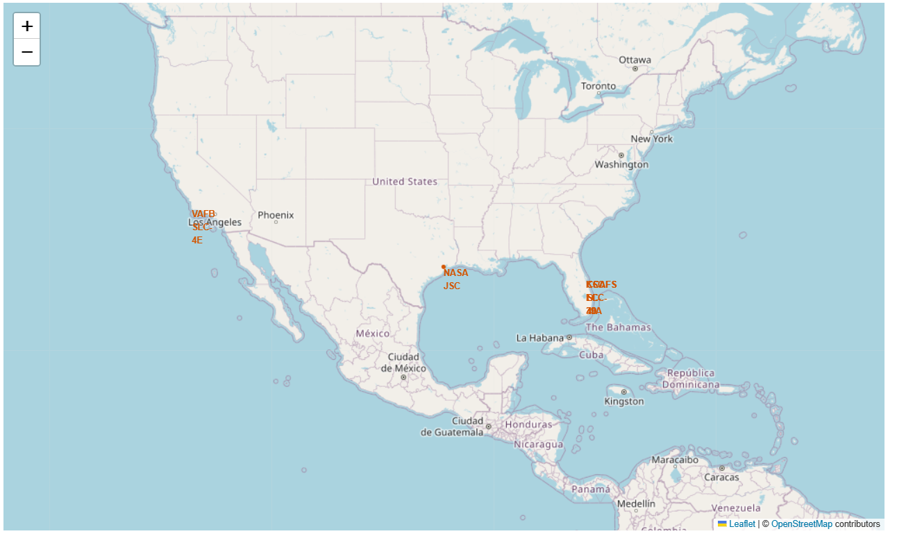
All Launch Sites Location Markers
Every launch occurs close to Florida, California, and the United States.

Slide 37
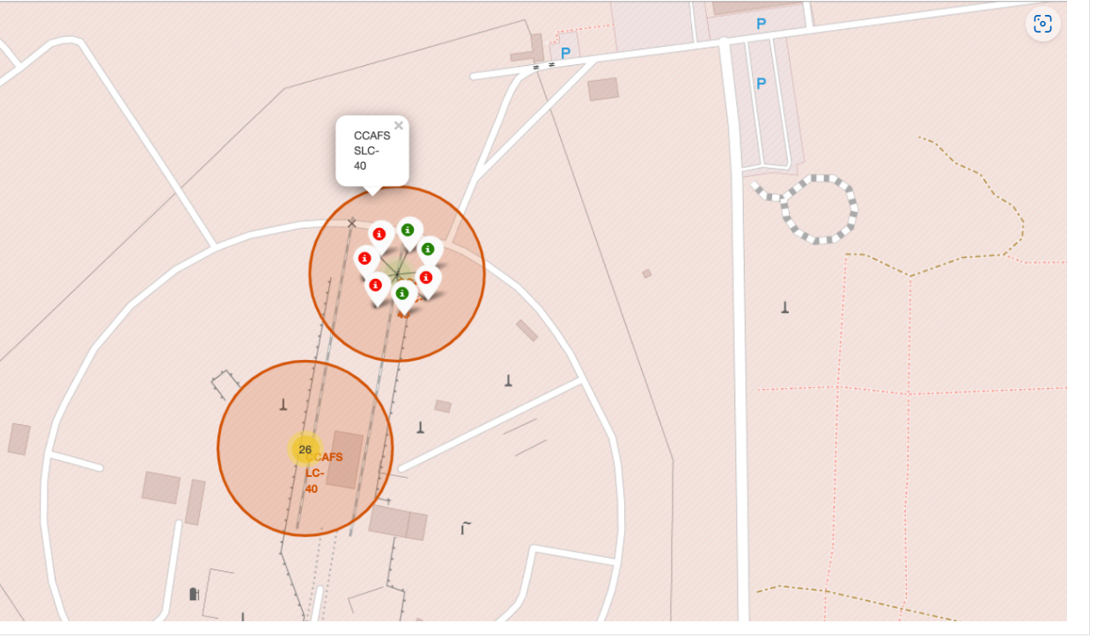
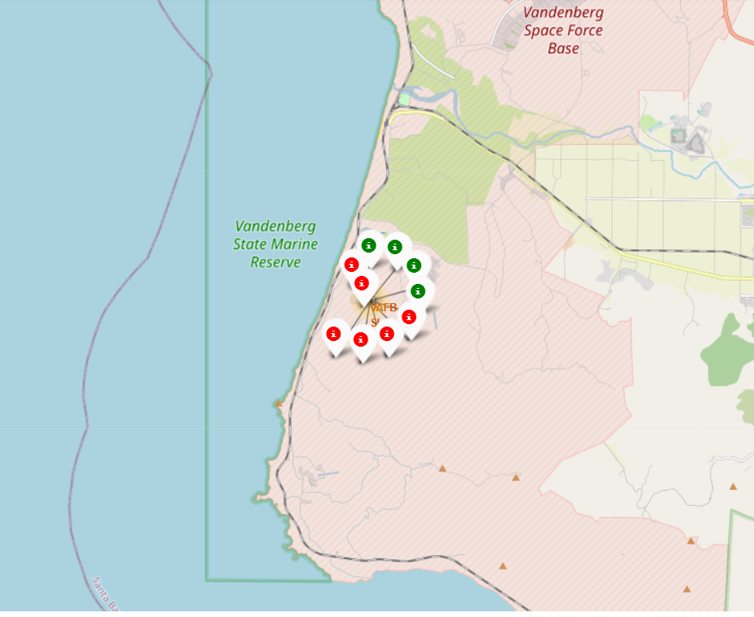
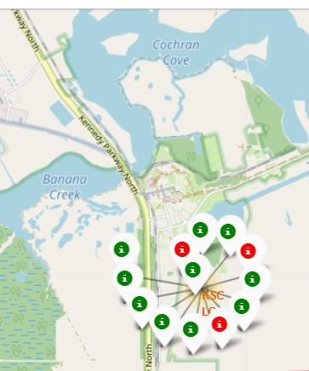
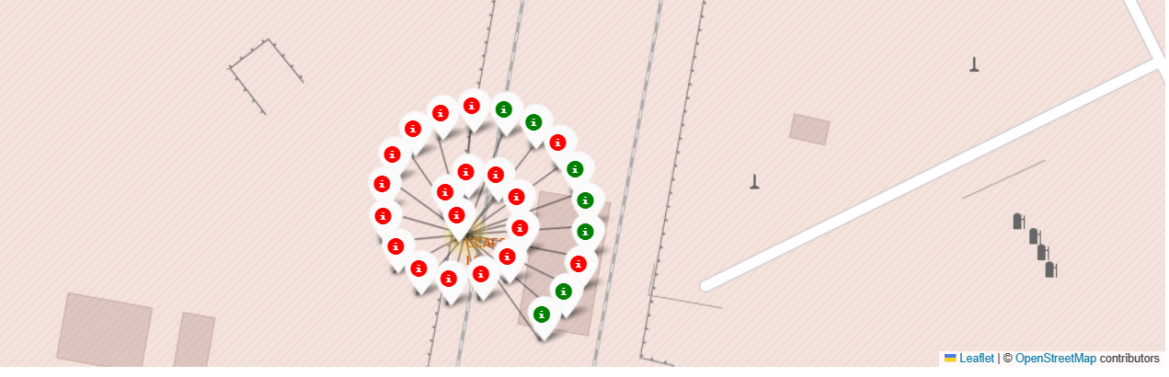
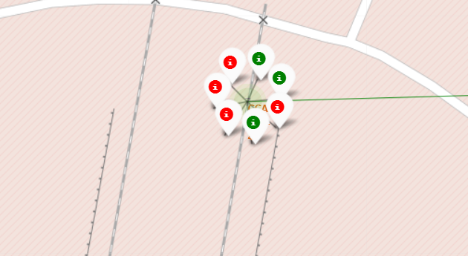
Color Labeled Launch Outcomes
Green means successful & Red means Failure

Slide 38
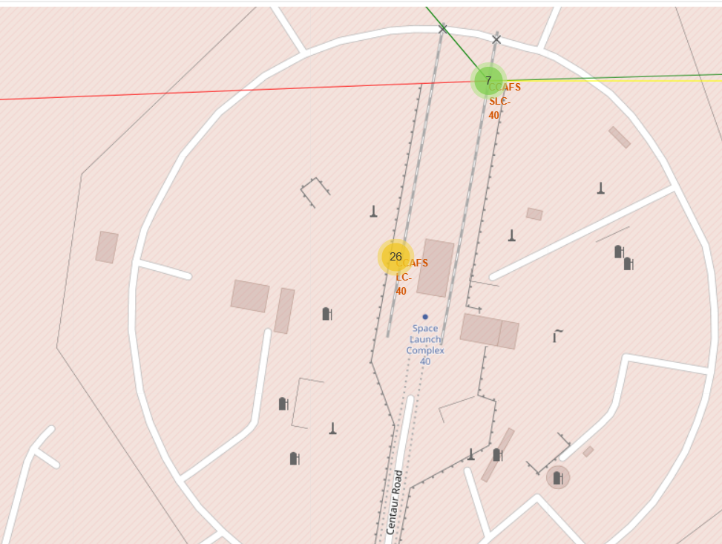
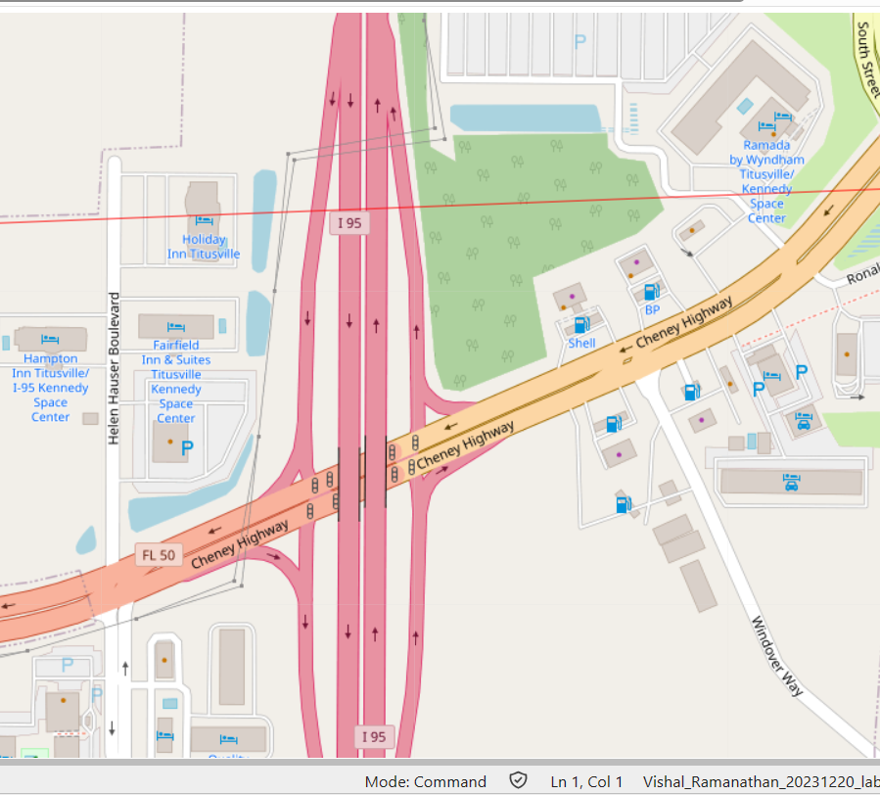
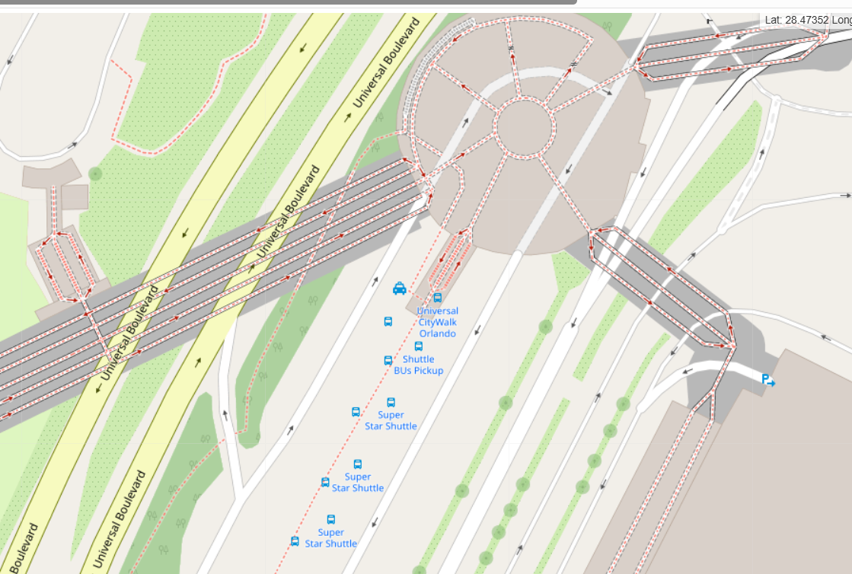
Launch Sites in Close Distance
The distances between the launch sites and their proximity to railway tracks were quite short.

Slide 39

Section 4

Slide 40
Launch Performance Index
With 41.7%, KSC LC 39A has the highest success rate.
CCAFS LC 40 follows with a 29.2% share.
Finally, with 16.7% and 12.5%, respectively, VAFB SLC 4E and CCAFS SLC 40.

Slide 41
Launch Location with Best Rating
With a payload range of 2000 kg to 10,000 kg, the KSC LC 39A gets the greatest score of 76.9%, while the FT booster version has the highest score.

Slide 42
Payload vs. Launch Outcome
First Screenshot shows the payload 0kg - 5000kg.
Second Screenshot shows payload 6000kg -10000kg.

Slide 43

Section 5

Slide 44
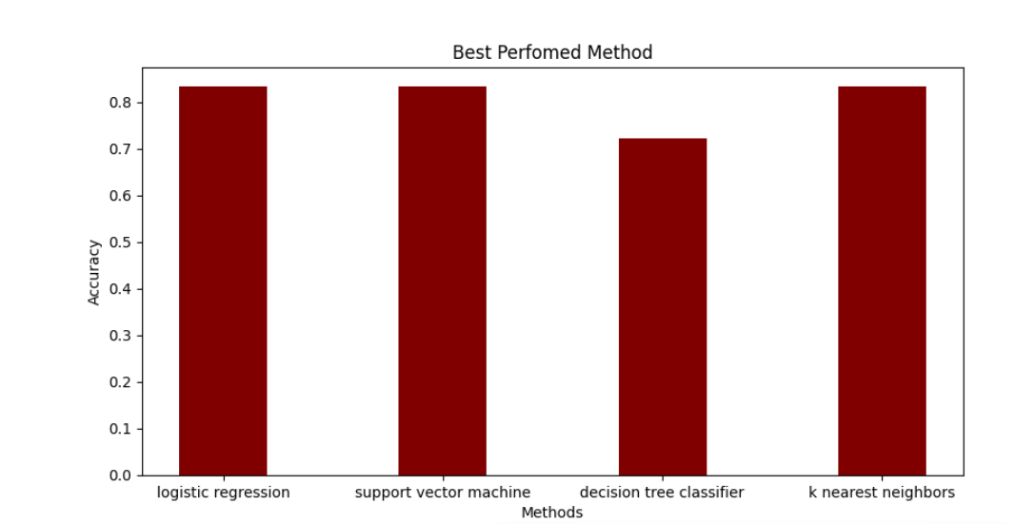
Classification Accuracy
Here K nearest Neighbors have the highest accuracy and other three methods have the same accuracy hence we are choosing K nearest for classification.

Slide 45

Confusion Matrix
The decision tree classifier's confusion matrix demonstrates the classifier's ability to discriminate between the various classes.
False positives are the main issue.i.e., the classifier interprets an unsuccessful landing as a successful landing.
The selected Logistic Regression model's confusion matrix is displayed in the graphic.
Only three labels were incorrectly predicted by the model.

Slide 46
Conclusions
We can then draw the following conclusion :
The success rate at a launch site increases with the number of flights conducted there.
The launch success rate increased from 2013 to 2020.
The success percentage of rocket landings rose dramatically starting in 2015. It was also evident that the number of flights had an impact on landing success.
Orbits with the highest success rate were ES-L1, GEO, HEO, SSO, and VLEO.
Out of all the sites, KSC LC-39A had the most successful launches.
For this problem, the optimal machine learning algorithm is the decision tree classifier.
Their launch sites are all situated away from neighbouring cities and close to the coast. They were able to test their rocket landings with minimal interruption thanks to this.
A machine learning model that can forecast the outcome of rocket launches with an accuracy of 83.33% was trained using all of this data.

Slide 47
Appendix
Relevant codes have been submitted to the Github supplied below :
Github link : https://github.com/Sivaraman-VishalRamanathan/FINAL_CAPSTON_PROJECT_IBM_DATA_SCIENCE/tree/main

Slide 48


